Slide 1
An Overview of ISAIC
Notes:
Good morning - Thanks for invite XYZ for organizing. I’m XYZ and XYZ is also here from ISAIC.
It seems there XYZ in audience - please say hi in chat and tell us which area you’re from, what you most want to learn today. And feel free to use chat to ask questions anytime.
The presentation is about 15mins - a quick introduction then the Why? What? Who? of ISAIC. Then questions - the frequently asked questions or yours directly

Slide 2

Industry Sandbox & AI Computing
ISAIC [ai-zey-ihk]
meet the needs of small and medium enterprises (SMEs) for the infrastructure and know-how that accelerates adoption and commercialization of AI in Western Canada.
~3000 tech cos in AB
340,000 SMEs in W.C.
an increase of 149% over 2018
account for 92% of W.C workforce
⅔
~16,000 tech jobs in AB
start-up survival rate past year 5
51.3% projected rate of AI adoption for SMEs
Notes:
To clarify, ISAIC, the acronym which stands for Industry Sandbox and AI Computing
ISAIC is physically located (meaning the infrastructure and workstations) at the University of Alberta from where service is extended across campus, the province and Western Canada as a for benefit organization
In short, we provide scalable, tailored, virtual computation and sandboxing environments with in person tech support that helps local companies on their AI adoption journey
Some stats give some context on this our (and for many of you) market
(Industry Canada, 2021) approx 340,000 SME’s in WC, making up 92% of the total Western Canadian workforce
(Deloitte) forecasted annual growth for rate for AI adoption in Canada through 2023 is 51.3% for SMEs
(Industry Canada) new start-ups = every year an average of 96,000 SMEs’ are created in Canada. 80.5% of these survive past year 3 and 66.2% survive past year 5
(Alberta Enterprise, 2021) 3,083 tech companies in AB, a 149% increase over three years ago
(Industry Canada, 2020) ~16, 380 tech jobs in AB. A100 is driving for 75,000

Slide 3

AI Adoption Requirements & SME Challenges
Human Competency
Data
Algorithmic innovation requires
AI skills
IT skills
domain understanding
change & buy-in
Limited access to data
Data may not be ready for AI
Potentially missing insights due to disconnects in data or inability to share across data sets
Ethics processes & support may not be available
Factors Driving Application of AI
Computation
Limits the speed at which AI solutions can be developed
Under-recognized - cost, egress, IT divorce
On prem is still prevalent, hybrid newest
Market offerings are complicated and fragmented
Notes:
Likely a reminder, the high level requirements for any AI project are data, compute and people skills.
Data and data scientists are generally well recognized now as core elements of AI / ML projects
AI / ML projects is clean, normalized, high quality training data. 60-80% of the time spent on the project is taken up here. And the key to high-quality training data is a process to obtain, analyze, and curate the data. Training data rarely arrives in a high-quality form [ ] somebody has to take the time to bridge the gap between the creators of the data, and the people (e.g., ML researchers) analyzing the data.”: Paul Lu 2018 University of Alberta.
Computational resources (or compute) are often under-recognized - especially as a cost given the expectations of up front credits, hardware speed of evolution and alternatives and mid-long term implications of vendor lock-in - and compute is often not included in project charters or grants
and for People - systems, computer and electrical engineers, domain experts, software developers, Ux/Ui, etc are also critical to a successful project yet less known alongside the critical project and change managers and translators or integrators of value and ROI

Slide 4
Why?
Founding story
Position
Notes:
So that’s where ISAIC fits in

Slide 5

Driven by Doers
(Entrepreneurs, Inventors, Innovators)
Benefits to SMEs:
Faster and affordable compute resources
Reliable, secure and shareable
Dedicated yet scale on demand
Best use tech skills (i.e not maintenance)
Supported and tailored
Connected to other resources
Notes:
ISAIC is a result of entrepreneurs, founders, and institutional doers that have / had ambitions to build AI solutions, platforms and products
They wanted access to high performance infrastructure and ability to scale up or down anytime. They wanted to be able to keep up with the super fast evolution of hardware yet not have the risk, maintenance, cost or time spent outside their core AI tasks and client aspects of the business.
Particularly for AI with its training versus production requirements, they saw value in a shared model and set out to leverage - for business - the strength of collaboration, reliability of an institution, talent of engineering in Alberta, emerging skillsets of students and the AI reputation of the University
ISAIC emerged as a shared resource driving for easy access for industry, nimble to serve goals in emerging technology and data.

Slide 6


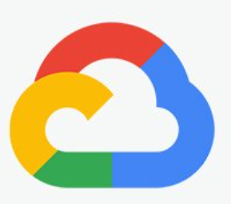

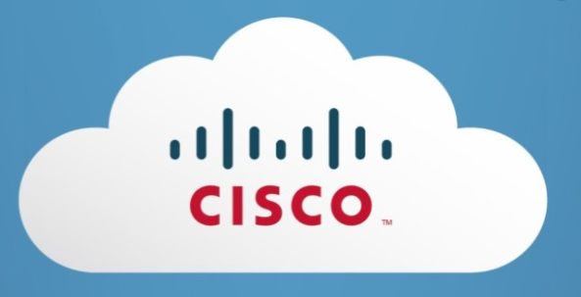

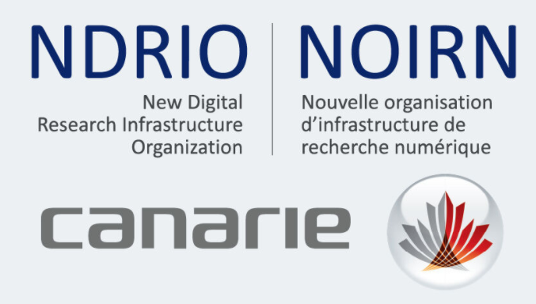


Options for AI compute - prior
Local
In-sourcing & On-premises
Purchased hardware/infrastructure becomes obsolete
Hard upkeep & scale (human resources, capital, space)
Cost due to speed of evolution & intermittent use
OTT
Proprietary
Open Source
International Cloud Providers
Platform effect
Switching costs
Unpredictable costs
Automated support
Research compute, Niche
Scheduled
By competition
Limited access
International
Notes:
At the time, the landscape and choices for compute infrastructure looked like
On premises
Commercial cloud providers
Research compute (which SMEs don’t have access to)
And there was some big risks, principally
Uncertainty and the black box of costs
Automated versus human support
Affordability as getting fast performance was expensive (budget and satisficing)
Speed of change (depreciation in 2 years or less versus 4 for example)
Vendor lock-in
Data security, sovereignty, re-use
IP - Data science service providers, either large or local, may claim rights to use data or keep IP related to consulting or services they offer the SME. ISAIC and non-profit partners build trust and offer an alternative and support local ecosystem benefit.

Slide 7

Options for AI compute - current
Local
On-premises, Co-location
Purchased hardware/infrastructure becomes obsolete
Hard upkeep & scale (human resources, capital, space)
Cost due to speed of evolution & intermittent use
Relationship-based support
No lock-in or hidden charges
Scalability & secure
I.P. is Yours, data sovereignty
Less risk, no maintenance
OTT
Proprietary
Proprietary
Open Source
International Providers, Hybrid
Platform effect
Switching costs
Unpredictable costs
Automated support
Research compute
Scheduled
By competition
Limited access
Capacity versus demand
International
Notes:
Provide a “friendly neighbourhood cloud” proven and leading hardware suited to SME requirements with support for questions, problem solving and links to research, other ecosystem supports
Whether developing an AI product or platform, seeking a business solution using AI, or looking to achieve optimization, ISAIC offers flexibility, scalability and the relationship based support that empowers small & medium enterprises to adopt and commercialize AI.
Some of the key
Scale & affordability for performance and fast iterations,
Cost and skillsets for operations & maintenance
Human support
Security, Privacy and Ethical concerns as well about data usage.
IP ownership
Proprietary systems or encryption of your data as well

Slide 8

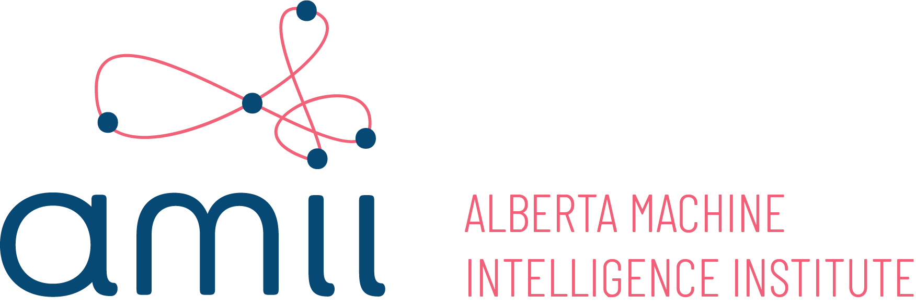

Local Organisations that can help
Domain Understanding
Industry specific or turnkey = “develop powerful software applications”
IT Skills
AI Skills
“infrastructure & applied knowledge”
“cultivate scientific excellence, develop talent and coach”
“driving growth through digital technology”
Source: Gartner
Notes:
How they’re packaged together creates different options for SMEs -
We work together and compete, which from the industries I’ve been in - engineering, construction, environment, trade, finance - is normal

Slide 9



Your “Friendly Neighbourhood Cloud”
Open-Access, Cloud Compute
(AI Garage)
Secure Experimentation & Data Collaboration Environment*
(Data Sandbox)
Applied Knowledge for AI Adoption
(Hub)
Affordable, tailorable, flexible GPUs, CPUS, platforms, tools, environments, add-ons, etc.
Infrastructure as a backbone
Secure, local collaboration environment for SME’s, industry working with researchers, events,
Storage options
Partner and assist directly to data related constraints for using and sharing data
Tailored supports, connections and problem-solving for SMEs in Western Canada
Bringing together entrepreneurs, researchers, firms, and students
Notes:
Talked about what ISAIC is at a high level, more specifically what we are is
computational resources and tools - think of it as a virtual garage - private and shared - where you can train and learn on some powerful equipment both proven and leading that often is not available, particularly to SMEs
data sandbox is a place to bring together data, find data and work together in a secure, less-risk virtual space where collaborators can get the right combinations, resources, pre-process to train algorithms
and the community is about the mentoring, match-making and game-changing coalitions that make sense for SMEs (which you know well at Innovates)

Slide 10
What?
ISAIC is
Benefits to SMEs

Slide 11
Save Time: Compute, Maintenance & AI Skills, Partners
The IT value to me is more than just hardware; it saves my CTOs time to work on tasks other than taking care of computer equipment
“With more computational power you cut the time down [and can] make decisions three times faster. Everything in ML is computational time. Reduction in time. Test your hypothesis fast without burning through your cash.”
[What I was working with] takes several hours until the training finishes; it moved from 10~13 hours to 15 to 20 min.
“Operations that once took us up to 50 - 100 seconds, are completing on [ISAIC’s] platform in around a second.” (Scale-up)
Our project shifts from 3-4 months to 3-4 weeks
Notes:
Because time is money, particularly for the time strapped CEO and CTO of a start-up. ISAIC means
accelerated compute time
valuable IT tasks, less maintenance
fast failure (lots of testing)
people to talk to (AI skills, systems, security skills, domain skills, tech skills, hardware knowledge, etc) + researchers + you TDA’s add the business skills)
people resources (students, experts, various disciplines & skills)

Slide 12


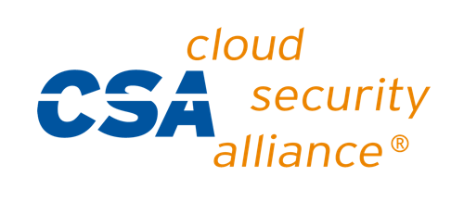

Save Worry: secure, local and dedicated; IP is SMEs
Working with the U of A Privacy & Security Office, we are in a process of conducting a HECVAT audit which maps to industry standards such as;
CIS Critical Security Controls v6.1
ISO 27002:2013
NIST Cybersecurity
NIST SP 800-171r1
NIST SP 800-53r4
“ISAIC’s team was there working through a virtual gateway to support our team, ensure data security” (Small enterprise)
Notes:
Higher Education Community Vendor Assessment Toolkit (HECVAT) and NIST cloud standards checklist
This matters because a typical SME would not be able to undertake the time or cost to do this type of security assessment
Yet its high value when they have clients who want the guarantees such as in health, defense, industrial or just about any industry
(one of our clients told us, ISAIC gave us, as a 5 person start-up, the credibility, scalability, security and reputation of the University to actually have a conversation with a large defense client in US)
Also, a large time and expense to maintain not to mention the policies, protocols for which the U has the required professionals in place. Thus ISAIC, taking an SME perspective, structure and culture can leverage this to benefit start-ups and SMEs
IP also of big mention; we are clear that we are environment only. We do not take a position in IP. The benefit is for the companies.

Slide 13
Who?
Start & scale ups
SME clients
Other
Notes:
Think we’ve established our SME focus yet here we’ll get into examples

Slide 14



Client Use Cases: Building AI Platforms
Commercial
Agriculture
Health
Notes:
First is clients who are building AI for others to build AI. For these examples the speed and ability to scale (selling to larger clients or many clients matters)
Clinisys - All the projects we are undertaking, we would not have dreamt of doing, but the speed (compute power) makes it possible to do various projects and continue new streams of projects because they are going so quickly.
Stream - Builds credibility for us - leverage how this with the University has trust and how amii/ISAIC with us can all be perceived on a global stage (access to scalability within a trusted institution when we are so small)
Provides value as an Alberta advantage

Slide 15

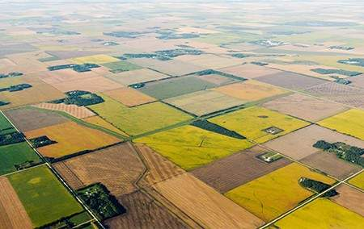

Client Use Cases: Custom & Pilot AI Projects
Challenge
Specific problem
Gap in industry
Environment = ISAIC
Faster, little $ to test
Limited duration
Results
Go / no go on further development
Notes:
Software and tech companies who continue to test and develop new AI products and solutions or respond to clients needs (ie 24/7, new request)
Using ML model to classify bulk satellite imagery into “ag land” and “ag land with clouds”
Cloud cover can lead to inaccurate analysis and poor judgements for their clients
“It has been really helpful to have on demand 24-7 access to large scale compute, instead of waiting in a queue.”
The nature of ISAIC's offering made it easy to change satellite imagery providers and adapt the model to new styles of images quickly
Also lots of companies emerging and DIY adopters of AI, they want to develop this capacity, have their own data, want to understand and reuse

Slide 16



Client Use Cases: Industry-changing AI Products / Solutions
Agriculture
Pharma
Industrial
Notes:
Building new industry applications or new competencies in an industry

Slide 17


Client Use Cases: Data Related
“For Alberta, ISAIC is a mechanism to create
access to (health) data
facilitated use of real data in (university) classes
shared infrastructure and sandboxing; instead of every researcher having to build a lab or SME go on premise, a scalable, performance laboratory is available [though ISAIC]
This lowers the threshold for SMEs getting in the game
CDAs, NDAs and confidential clients
Notes:
We have data access, data storage, data accumulation and amplification examples; learning a lot here as we continue to grow which (maybe I can ask for your input) also the case for Alberta.
Makes me think of a comment from March when ITRC said “you need to build the value add for data” March 13,2021
Be the value added good versus the commodity
So we continue to ensure resources are available, to be flexible to unique needs of entrepreneurs/inventors with the vision and talent so they have a setting to collaborate with data and connect with researchers or peers

Slide 18




Other Clients & Use Cases:
Enterprising Researchers
Applied problem
Novel solution
EKG Pjt Calgary
AI Instructor
Limited resources
Access to real data, cos
Naiad Lab
Associations, Collaborations
Industry cos collaborating with data
Applied whole industry problems
SMEs working with researchers
Notes:
Some other use cases
For the entrepreneurial academics or their teams from any faculty (law, marketing, business, ag, health) or W.C. institution (definitely see as area for collaboration with AB Innovates)
AI instruction is a space we’ve found underresourced (considering huge growth 400+%) and the value for re-skilling, next graduates from any discipline

Slide 19



Local Events & Activities
Applied
(hackathons, connectathons, datathons)
Local AI Related (forums, conferences & speaking opps for and with SMEs)
Sector / Start-Up Focus (accelerators, pitches,forums, association events)
Notes:
And we organize, co-organize, speak, sponsor and have various roles in events - the core question for our fit is whether it has applied tech or SME focus and serves local audience - that’s our niche.

Slide 20
Frequently Asked Questions
Notes:
So that’s the overview.
Time - we still have ## mins
So - I can take you ?s or have 5 FAQs prepared

Slide 21



What makes different?
Faster / Scalable
Security
Certainty
Local
Simpler
Notes:
Accelerate. At whatever the scalability and tailorability companies need, our compute resources give the dedicated environment and speed that makes sense and stays affordable
Trusted, sovereign and local. Part of our mandate is to diversify Western Canada’s economy. Data is secured in Canada.
Ownership. Our users own and retain their own IP. Our environment is protected at multiple levels and admin access to the VM is only there if clients want it to be.
Certainty of price and availability. allows users access to their virtual machines at any time. Clients train at their pace, not at a providers.
Simple. We approach service with applied knowledge. ROI is our business goal, so we tailor to your needs and dive in as much or little as needed to provide practical solutions that to drive to results.

Slide 22




How does the client start with
Step 1
Step 2
Step 3
Step 4
Discovery
(call or online)
Verify
(systems, basic requirements, sign-on, confidentiality)
Launch
Follow-up (support and services)
Notes:
It’s a few easy steps once we’ve been introduced to a company.
Step 1: Discovery call:
This is where we first get to really know the client. We want to know you, and how we can amplify and accelerate
Typically about 30 min
We find it’s helpful to have the opportunity to share a high-level overview of ISAIC, who we aim to serve, the benefits
This give you the chance to ask questions that matter most to your business
What your constraints are, what would take you to the next level
Step 2:
Next, you would receive a couple of forms to complete. This help us baseline on your company and needs
We share TOS and AUP for review. This allows you to review up front.
We may schedule a follow-up call if there is anything we need to follow-up on.
Step 3:
If everything looks good, we’ll use the public key shared you or your tech team to launch the VM.
It’s a free time trial to test and adjustment period
We can add additional storage, cores, tools and processing capacity
Step 4:
Follow up for hands-on support, intro sessions and applied knowledge

Slide 23
Pricing: laddered, pay for use, local benefit
Your Need
ISAIC Offering
Pricing Approach
On Demand
Hourly
Subscription
Pricing calculator
Standard Offerings
Project Based, Iteration
Fixed fee
Subscription + hourly
Quotation based
CapEx / OpEx Spend
Custom Offerings
Mid-Long Term, constant
Term Subscription
Quotation based
Procured infrastructure
Contract based
Managed Colocation
Shared Infrastructure
** Free time trial for virtual machine, onboard or offboard anytime

Slide 24
Questions

Slide 25

Contact Us
www.isaic.ca
Crys Vanier, Executive Director
crys.vanier@ualberta.ca
Technical Team
support@isaic.ca
@poweredbyisaic
LinkedIn.com/company/poweredbyisaic

